Slide 1
Genetic Algorithm For Chess: Search and Evaluation Functions
COMP 8120 - Software Engineering/Distributed Systems
Vlad Tusinean
Matthew Belanger

Slide 2
A Dynamic Agent
Previously, the chromosome was a sequence of moves
This resulted in optimizing for the best random game
Agent was not dynamic, could not respond to any other input move
Could not be played against
Rather than a sequence of moves, chromosome needs to represent a way of evaluating the position
Can be a vector of weights corresponding to different chess concepts
Material advantage, king safety, center control, etc.
For each move:
Agent receives the board state
For each legal move:
Agent evaluates the resultant position for that move
Agent selects the move that results in the best position
The evaluation function is manually programmed based on vector of weights
This allows the agent to play a human

Slide 3
Current Chromosome
The current chromosome contains 393 weights
Represents importance of different aspects of chess
Piece values
Agent can consider pieces to have a different value than their actual (weight pawns more, queens less, etc.)
Material score
Agent can prioritize material advantage or ignore it
Piece mobility
Agent can prioritize keeping a large number of possible moves available
Center control
Agent can prioritize keeping control of the center
Counts as having a piece in the center, or having pieces that attack/defend the center
King safety
Agent can prioritize keeping the king away from danger
Per-piece vector of 64 weights (one per square)
Corresponds to a “value” of a piece being on that square
Ex: Knights are less effective on the edge of the board

Slide 4
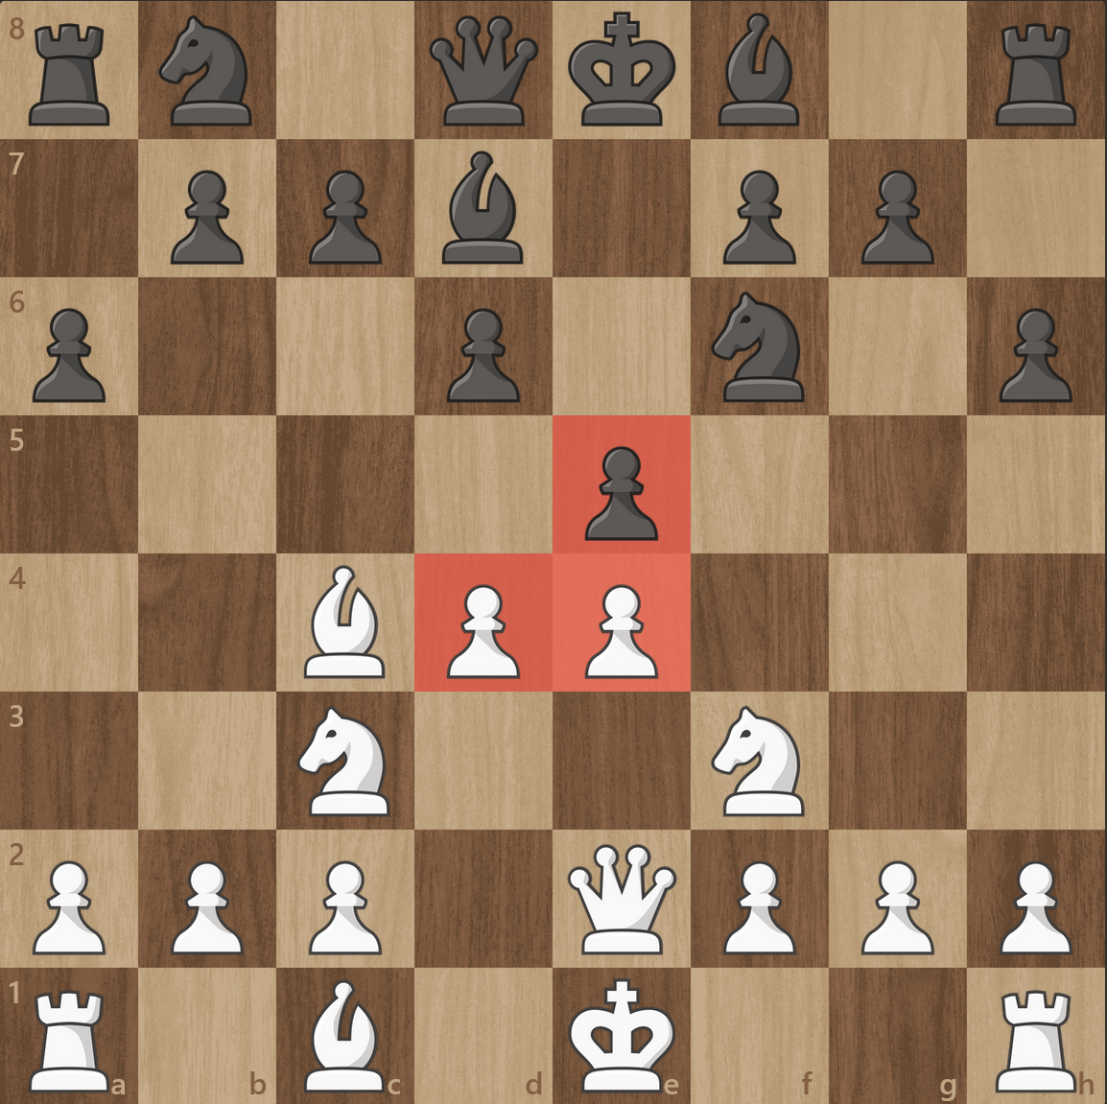
Center Control
Full weight given if any pieces are in the center four squares
Currently does not distinguish between piece type
center_control = center_control_weight * (2 – 1)

Slide 5
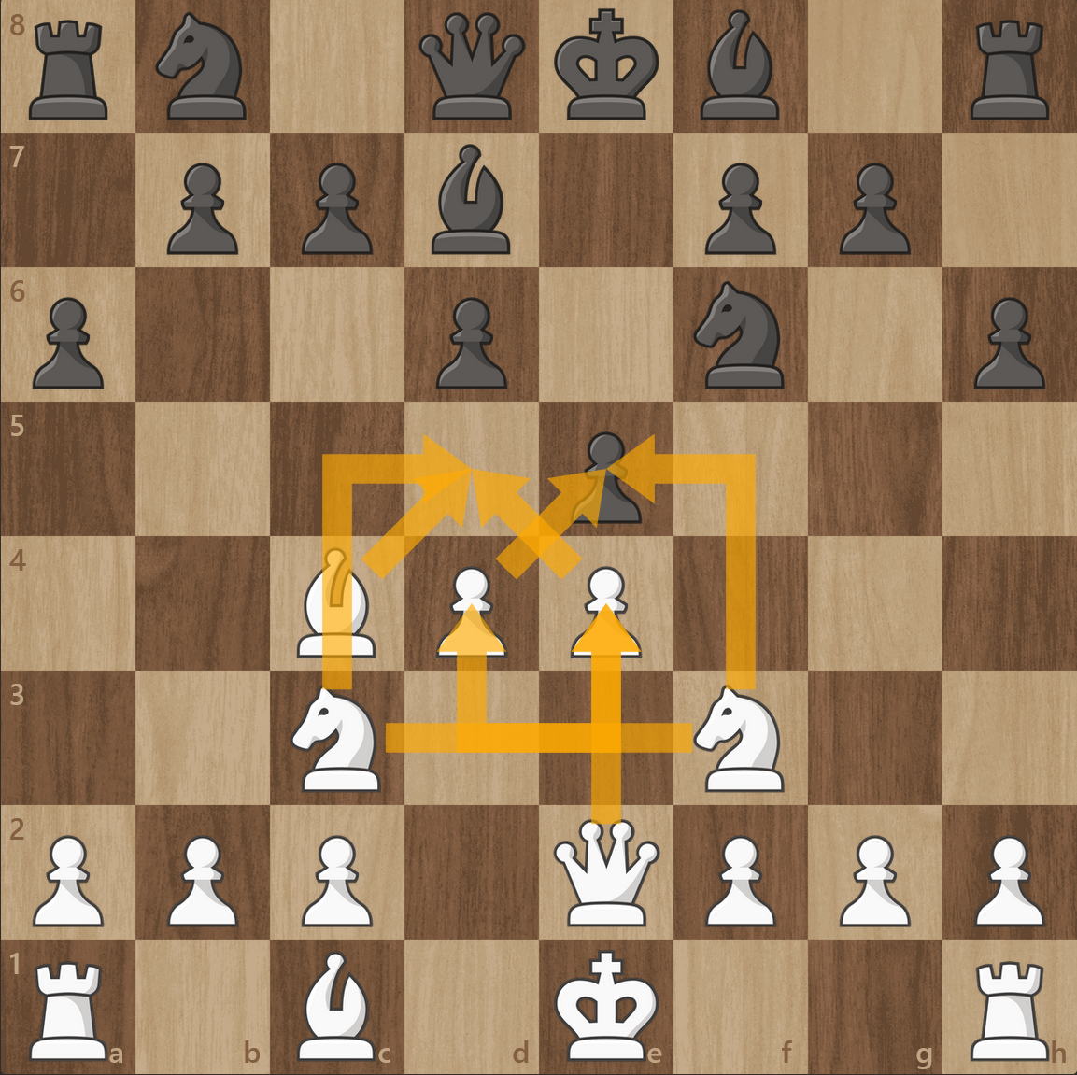
Center Control
Partial weight given to pieces that attack/defend center squares
Also currently does not distinguish between piece type
center_control = 0.5 * center_control_weight * (8 – 3)

Slide 6
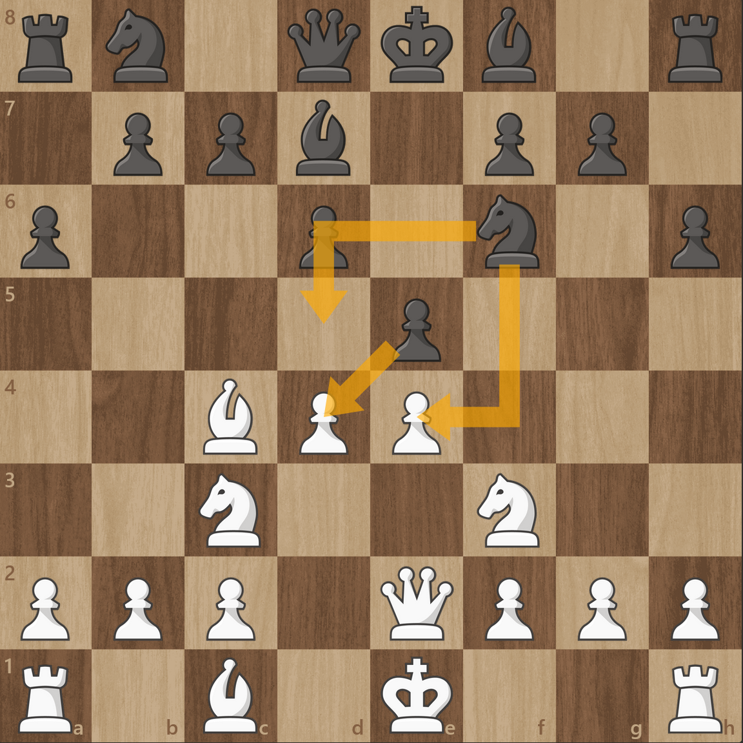
Center Control
Partial weight given to pieces that attack/defend center squares
Also currently does not distinguish between piece type
center_control = 0.5 * center_control_weight * (8 – 3)

Slide 7
Center Control
Partial weight given to pieces that attack/defend center squares
Also currently does not distinguish between piece type
center_control = 0.5 * center_control_weight * (8 – 3)
Hardcoded values are subject to change

Slide 8
King Safety
One of the more complicated things to evaluate
Adds a penalty for any of the following:
King is on an open file
King is next to an open file
Squares adjacent to king are empty
Squares adjacent to king have an opposite-color piece
King is not on edge of board
Next move of opposing player can place king in check/checkmate
King cannot move to a square because it will be check/checkmate

Slide 9
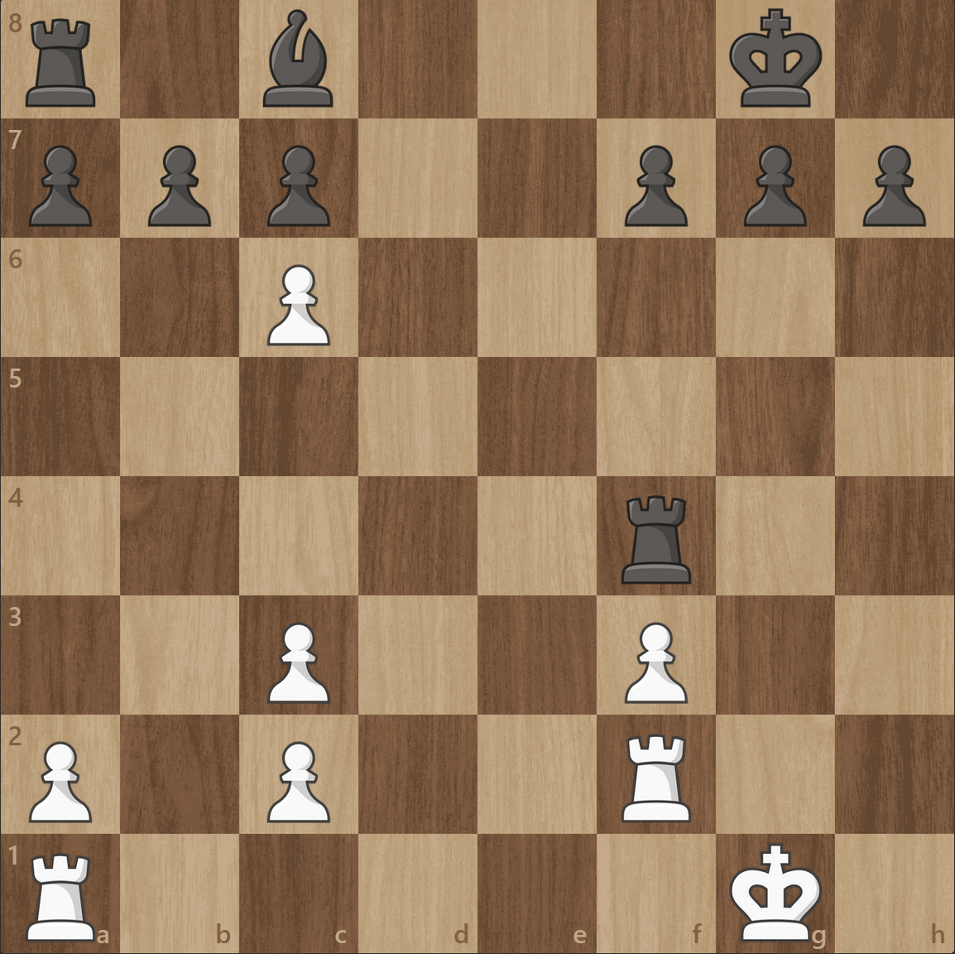
King Safety – Open Files
Defined as not having any same-side piece between the king’s rank and the opposing side of the board
If king is on an open file, apply full penalty
If next to open file, apply reduced penalty
Open Files

Slide 10
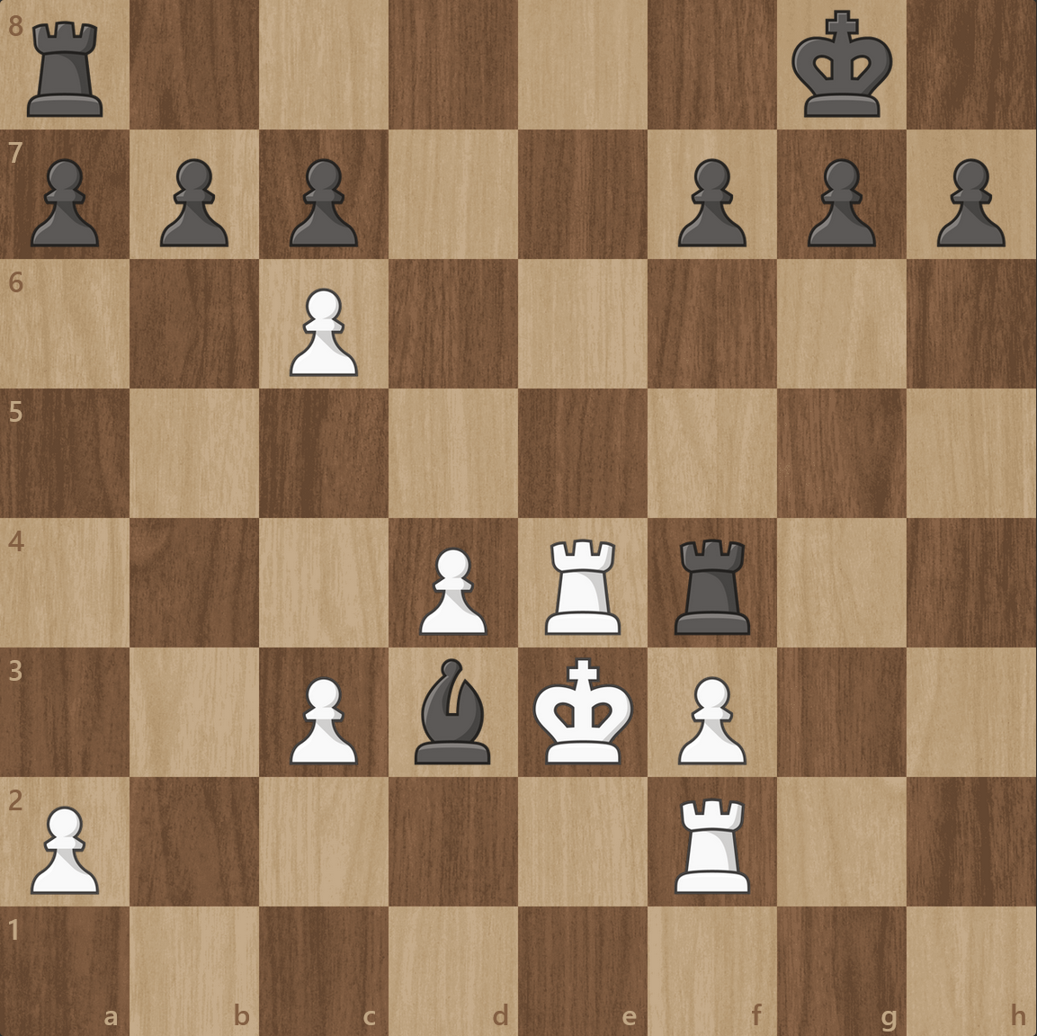
King Safety – Adjacent Squares
If king is next to opposite-side piece, apply full penalty
If king is next to an open square, apply small penalty
Full penalty
Small penalty

Slide 11
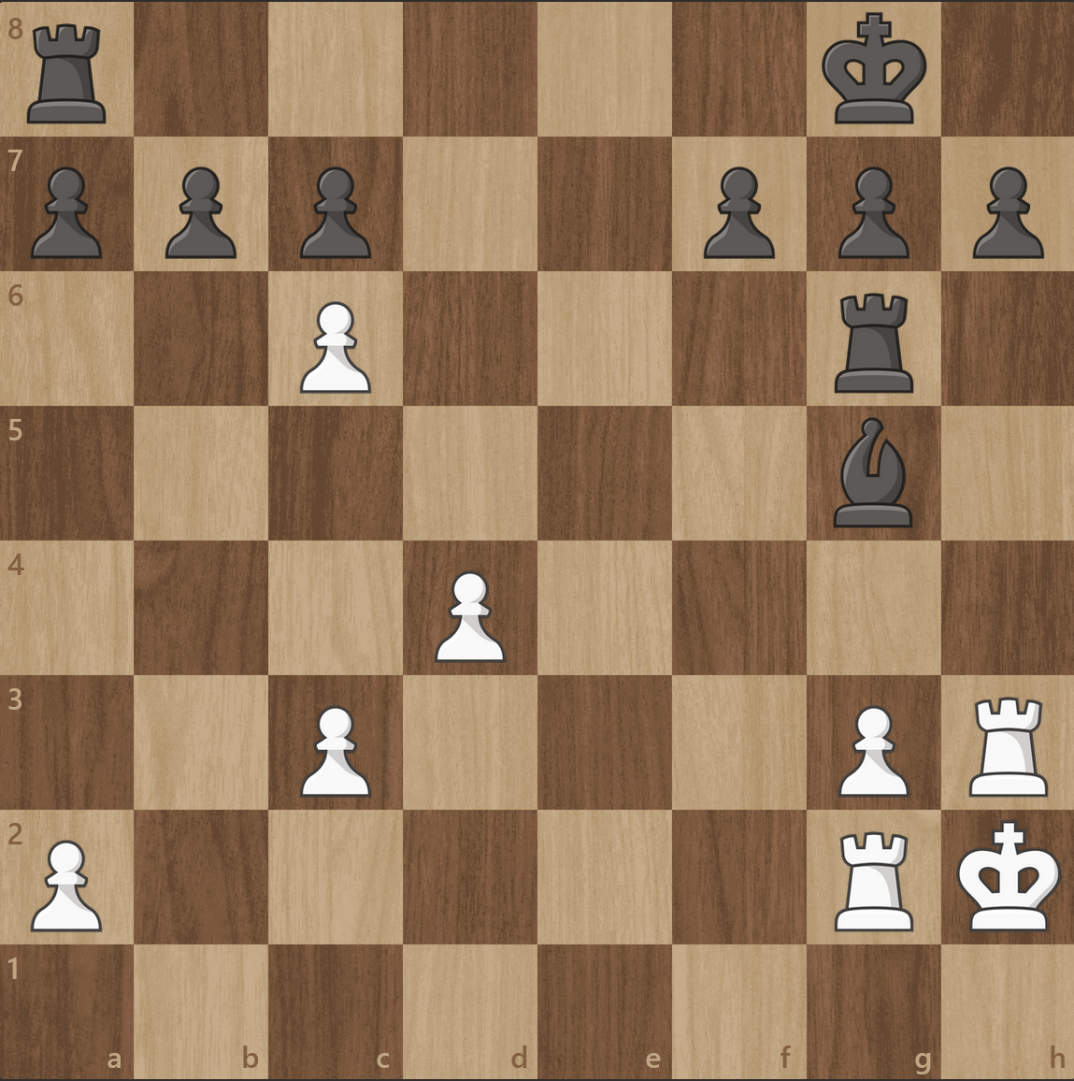
King Safety – Edge of Board
Full penalty if king not on edge of board
Reduced penalty if king not on starting rank
Starting rank

Slide 12
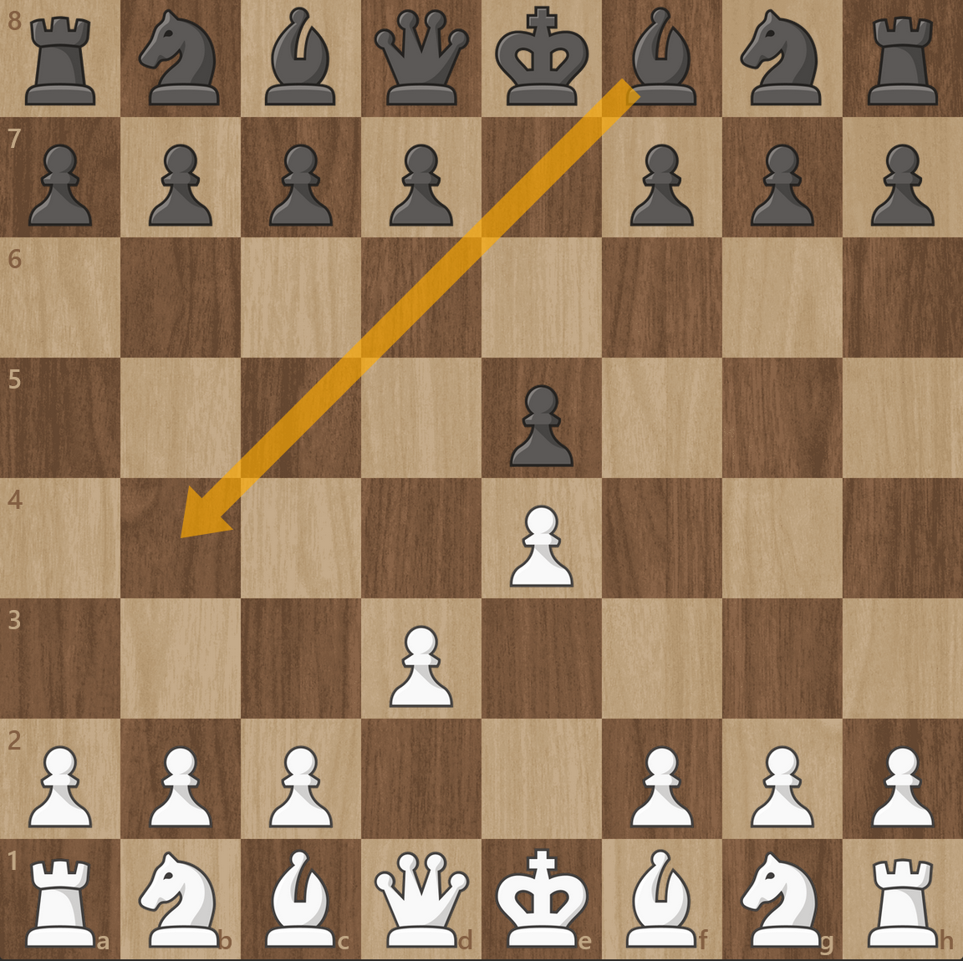
King Safety – Potential Check/Mate
Penalty if next move from opposing side places king in check/checkmate

Slide 13
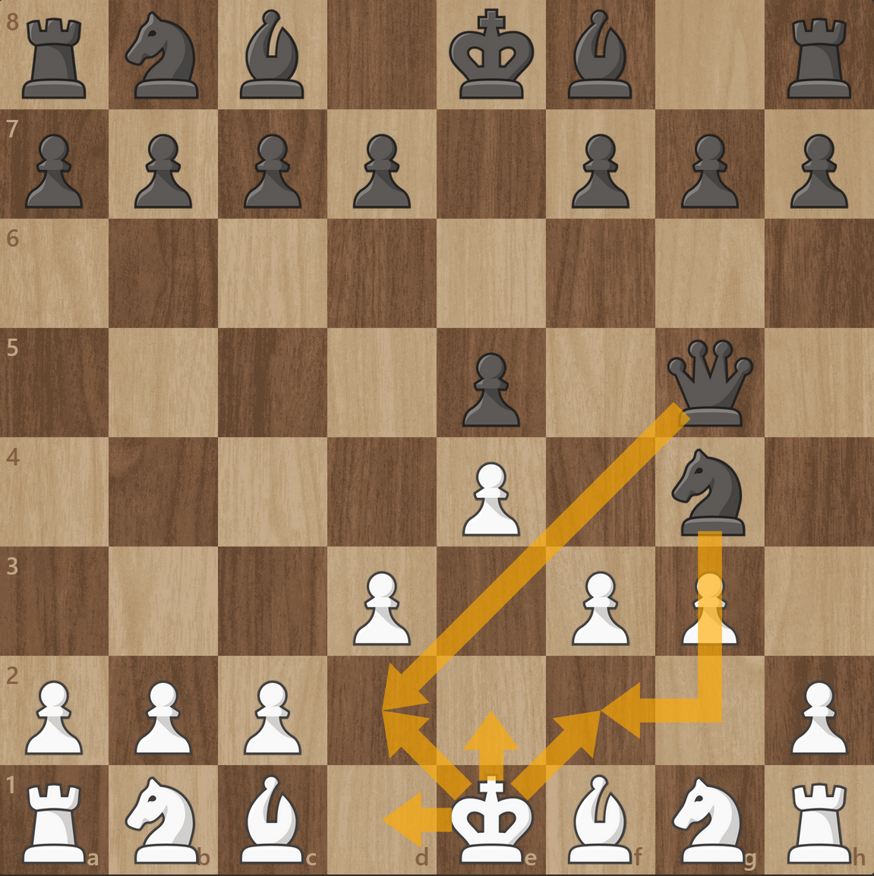
King Safety – Illegal Move due to Moving into Check/Mate
If king cannot make a move because it will be check/checkmate, apply penalty
Illegal moves

Slide 14
Search Function
We have the ability to evaluate the board, but we must generate the next move
For each legal move:
Evaluate the position if that move was made
Pick the best move across all possibilities
This is “Depth 1”, looking one move ahead
To make the agent more intelligent, we can increase the depth
i.e., look two moves ahead

Slide 15
Current Approach
Position evaluation is currently set to only consider white’s perspective
This will be corrected for next week
Each chromosome plays against a depth-1 stockfish
Each chromosome uses a depth-2 search before choosing a move
20 generations with population=20 takes several hours to complete
Weights are arbitrary, some computations are hardcoded
All 7 aspects of king safety use weight from the chromosome
This can be changed to 7 distinct weights
The next step is tuning, and improving the agent
Better weights, deeper search, etc.

